Slide 1




Encapsulation
What is Encapsulation, Benefits, Implementation in Java
Java OOP
Basics
SoftUni Team
Technical Trainers
Software University
http://softuni.bg

Slide 2


Table of Contents
Principles of OOP
What is Encapsulation
Access Modifiers
Benefits of Encapsulation
Encapsulation in Java

Slide 3
Questions
sli.do #8926

Slide 4
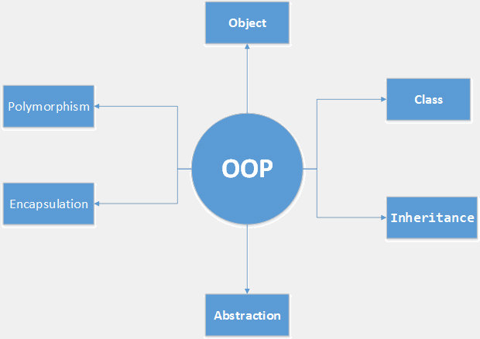
Fundamental Principles of OOP
Notes:
(c) 2006 National Academy for Software Development - http://academy.devbg.org*
4##

Slide 5
Fundamental Principles of OOP
Encapsulation
Reduces complexity
Hides internal data
Inheritance
Polymorphism
Abstraction

Slide 6

Encapsulation

Slide 7
Encapsulation
Hides the implementation details
Notes:
Encapsulation hides the implementation details
Class announces only a few operations (methods) available for its clients – its public interface
All data members (fields) of a class should be hidden
Accessed via properties (read-only and read-write)
No interface members should be hidden
Encapsulation == hide (encapsulate) data behind constructors and properties

Slide 8
Encapsulation – Example
Fields should be private
Person
-name : string
-age : int
+Person(string name, int age)
+getName : String
+getAge : int
+setName(String name)
+setAge(int age)
Notes:
Fields are private
Constructors and accessors are defined (getters and setters)

Slide 9

Access Modifiers (Visibility)

Slide 10
Access Modifiers
public
private
protected
default
Notes:
Access Level "public"
When we use the modifier public in front of some element, we are telling the compiler, that this element can be accessed from every class, no matter from the current project (assembly), from the current package. The access level public defines the miss of restrictions regarding the visibility. This access level is the least restricted access level in Java.
Access Level "private"
The access level private is the one, which defines the most restrictive level of visibility of the class and its elements. The modifier private is used to indicate, that the element, to which is issued, cannot be accessed from any other class (except the class, in which it is defined), even if this class exists in the same package.
Access Level “protected"
The access level private is the one, which defines the most restrictive level of visibility of the class and its elements. The modifier private is used to indicate, that the element, to which is issued, cannot be accessed from any other class (except the class, in which it is defined), even if this class exists in the same namespace.
Access Level “default"
This is the default access level, i.e. it is used when there is no access level modifier in front of the respective element of a class. Members can be accessed only from the same package.

Slide 11

Exercises in Class

Slide 12

Encapsulation in Java

Slide 13
Encapsulation in Java
Access fields through getters and setters
Notes:
Fields are always declared private
Accessed through getters and setters in read-only or read-write mode
Setters perform checks to fight invalid data

Slide 14
Encapsulation in Java (2)
Constructors and methods access level
Notes:
Constructors are declared public
Constructors perform checks to keep the object state valid
Interface methods are always public
Not explicitly declared with public
Non-interface methods are declared private / protected

Slide 15
Encapsulation in Java (3)
Data validation
Notes:
Constructors are declared public
Constructors perform checks to keep the object state valid
Interface methods are always public
Not explicitly declared with public
Non-interface methods are declared private / protected

Slide 16
Data Validation
Throwing exceptions
Notes:
Exception in java is an object, which signals an error or an event, which is not anticipated in the normal program flow. When such unusual event takes place, the executing method ’throws' a special object containing information about the type of the error, the place in the program where the error occurred as well as the program state at the moment of the error.
Each exception in java contains the so-called stack trace, which gives information of where exactly the error occurred.

Slide 17

Encapsulation Benefits

Slide 18
Encapsulation – Benefits
Reduces complexity
Notes:
Ensures that structural changes remain local
Changing the class internals does not break any outside code
Allows changing the internal class implementation

Slide 19
Encapsulation – Benefits (1)
Structural changes remain local
Notes:
Ensures that structural changes remain local
Changing the class internals does not break any outside code
Allows changing the internal class implementation

Slide 20
Encapsulation – Benefits (2)
Allows validations and data binding
Notes:
Ensures that structural changes remain local
Changing the class internals does not break any outside code
Allows changing the internal class implementation

Slide 21
Exercises in Class

Slide 22

Summary
Encapsulation hides internal data
Encapsulation Reduces complexity
Ensures that structural changes remain local
Access modifiers

Slide 23








OOP – Encapsulation
httpshttps://softuni.bg/courses/oop/

Slide 24

License
This course (slides, examples, demos, videos, homework, etc.) is licensed under the "Creative Commons Attribution-NonCommercial-ShareAlike 4.0 International" license
Attribution: this work may contain portions from
"Fundamentals of Computer Programming with Java" book by Svetlin Nakov & Co. under CC-BY-SA license
"OOP" course by Telerik Academy under CC-BY-NC-SA license

Slide 25






Free Trainings @ Software University
Software University Foundation – softuni.org
Software University – High-Quality Education, Profession and Job for Software Developers
softuni.bg
Software University @ Facebook
facebook.com/SoftwareUniversity
Software University @ YouTube
youtube.com/SoftwareUniversity
Software University Forums – forum.softuni.bg

